Slide 1
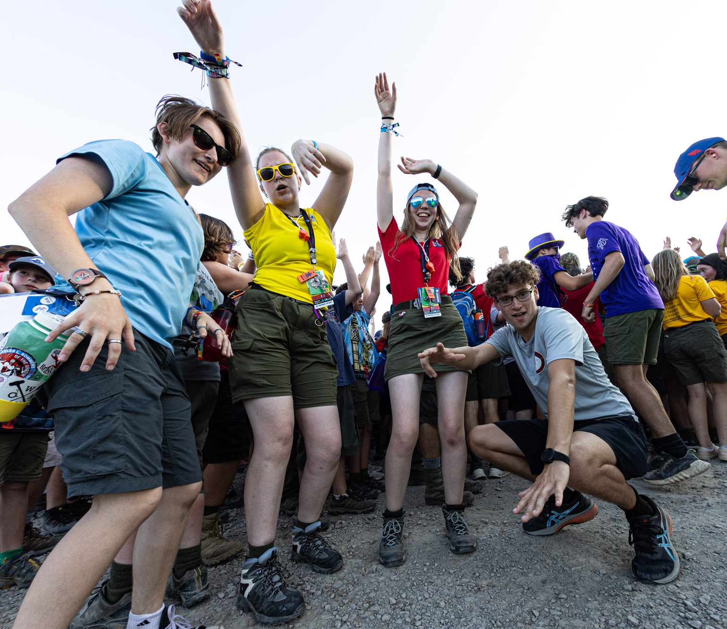
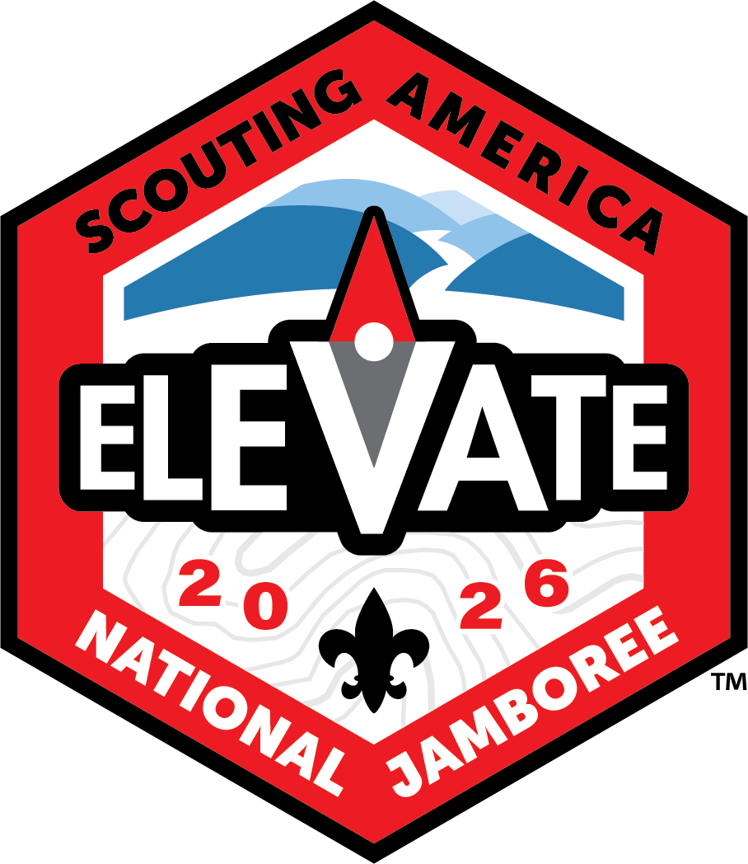
Notes:
The jamboree is the best of Scouting rolled into 10 days of fun, friends, and adventure, and you can be there to be a part of it!

Slide 2
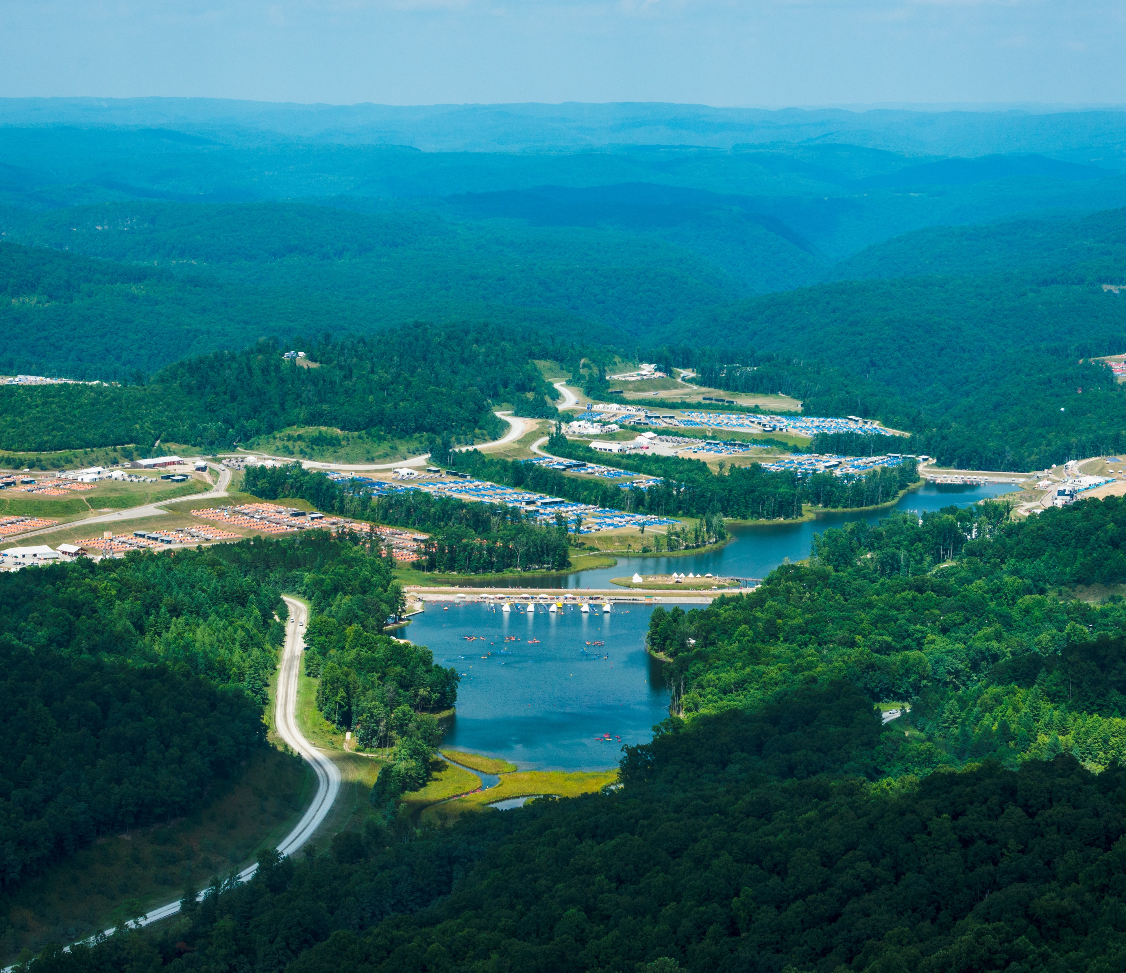
Notes:
The 2026 National Scout Jamboree will be held at the Summit Bechtel Family National Scout Reserve. We’ll call it the “Summit” from here on out.
The 2026 Jamboree will be the 4th National Jamboree at the Summit Bechtel Family National Scout Reserve in West Virginia’s New River Gorge region.
The 10,000-acre Summit Bechtel Reserve is adjacent to 70,000 acres of a federally protected national river area, one of the most amazing outdoor recreation centers on earth.
Thousands of Scouts and Scouters will explore all kinds of adventures—stadium shows, merit badge work, adventure sports, patch trading, and more—in the heart of one of nature’s greatest playgrounds.
Every few years, the national Jamboree brings generations together through Scouting’s biggest showcase. You won’t want to miss this amazing experience.
As the Jamboree happens only every few years a Scout typically only has one opportunity to experience the Jamboree as a youth during their time in Scouts BSA. The next one is not until 2029.

Slide 3
Notes:
The theme of the 2026 Jamboree, “Elevate” which will focus on how we can elevate the Scouting experience for each of the participants and Jamboree Service Team (staff) at the Jamboree.
The goal of the Jamboree is to help each person who attends the Jamboree in any way to Elevate their view of Scouting and have an experience that will help Elevate them to continue to grow in Scouting.
We plan to:
Elevate your network through programs in the camp areas
Elevate your adrenaline though high octane activities
Elevate your leadership through opportunities to learn leadership skills and put them into practice
Elevate your service through a service project to benefit the local community
It also reinforces one of the Summit Bechtel Reserve’s purposes of helping to redefine Scouting’s adventure for the next century. Participants of the 2026 National Jamboree will experience that difference every day.

Slide 4
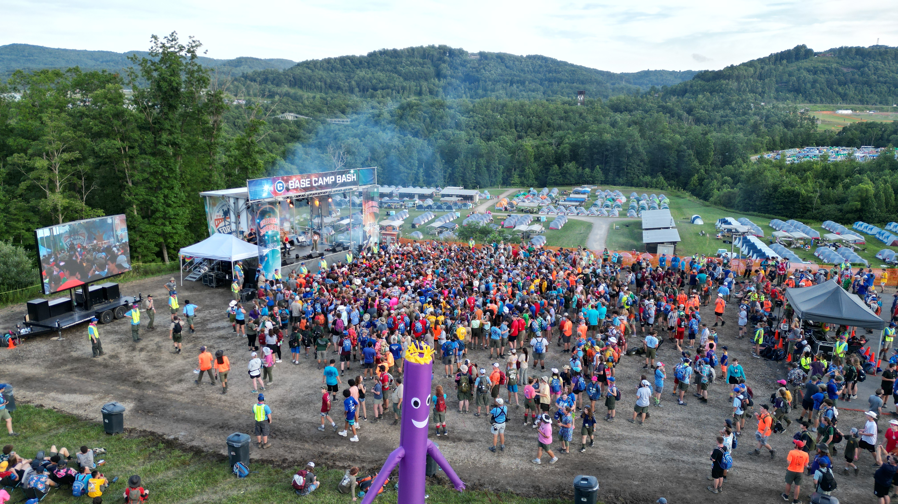
THE BEST OF
SCOUTING
IN ONE PLACE
Notes:
Our tradition of the Jamboree delves deeply into what it means to be a Scout.
For over 75 years, the national Jamboree has brought members from all over the country and the world together to share the bond that is Scouting.
Each Jamboree grows in numbers and in adventure, adding more and more activities for Scouts to turn into memories.

Slide 5
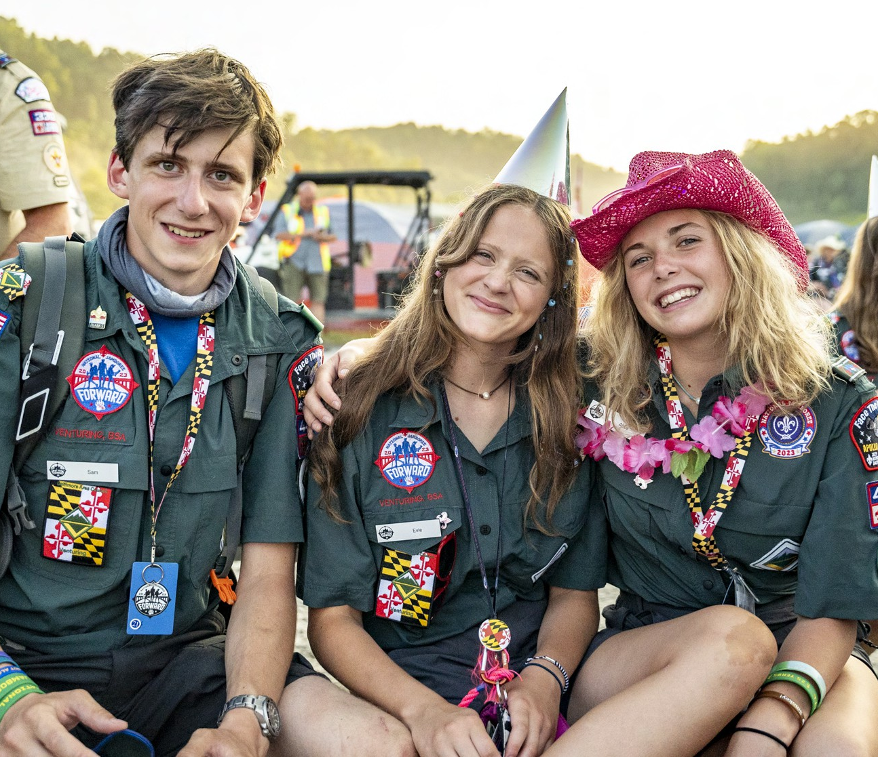
Notes:
Elevate your Jamboree through different experiences that the Jamboree has to offer.
Stadium shows
Patch trading
Worship services
Leadership heights
Adventure activity
Merit badges
Camp life

Slide 6
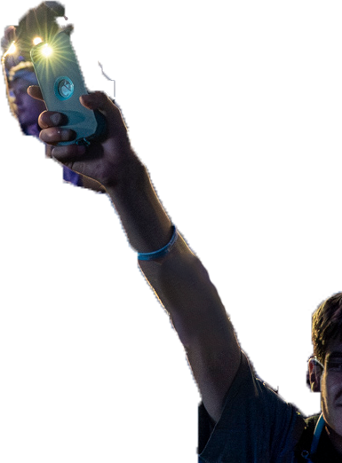
Notes:
We will Elevate your energy through exciting shows experiences.
The 2026 Jamboree will feature multiple opportunities for Scouts to come together to experience the Jamboree surrounded by a stadium full of friends celebrating Scouting.
Shows will consist of large Jamboree wide gatherings as well as smaller gatherings in each base camp on multiple nights.
Shows are our time to gather and celebrate that Scouting is bigger than ourselves, our unit, and even our council.

Slide 7
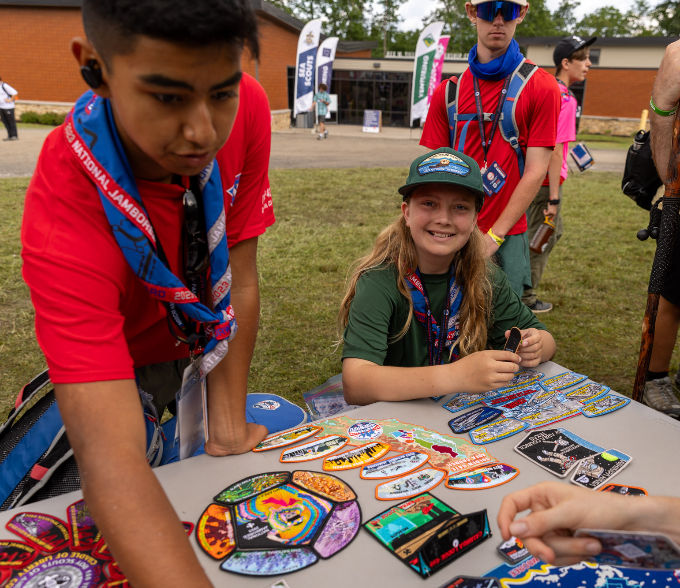
Notes:
Elevate you network of friends through one of Scouting’s long-standing traditions of patch trading.
All great Scouting events have patches and the Jamboree is no different. Bring some from your collection to trade and share or start a collection while you are there. Not into patches and trading? That is OK, just hang out in the patch trading areas and meet lots of new people.
Patch trading brings lots of Scouts together in something we all know – Patches. Not sure what patches are “worth”? Don’t worry we will have folks around the patch trading area to answer your questions and help you navigate the fun of trading. (and they may even have a patch or two to give away if you chat with them)
Patch trading—It’s not just about scoring the coolest patches; it’s about meeting other Scouts from all over the United States and beyond.

Slide 8
Notes:
Elevate your adrenaline though some of the Jamboree adventure activities
Whether it is riding a skateboard for the first time or maybe mountain biking or BMX you will have a chance to bring some thrills to the Jamboree through the adventure activities.
Ziplines, climbing and shooting are always popular activities at the Jamboree. Be ready to try some new things or just improve at something you love. Adventure programs will keep your adrenaline up at the Jamboree.

Slide 9
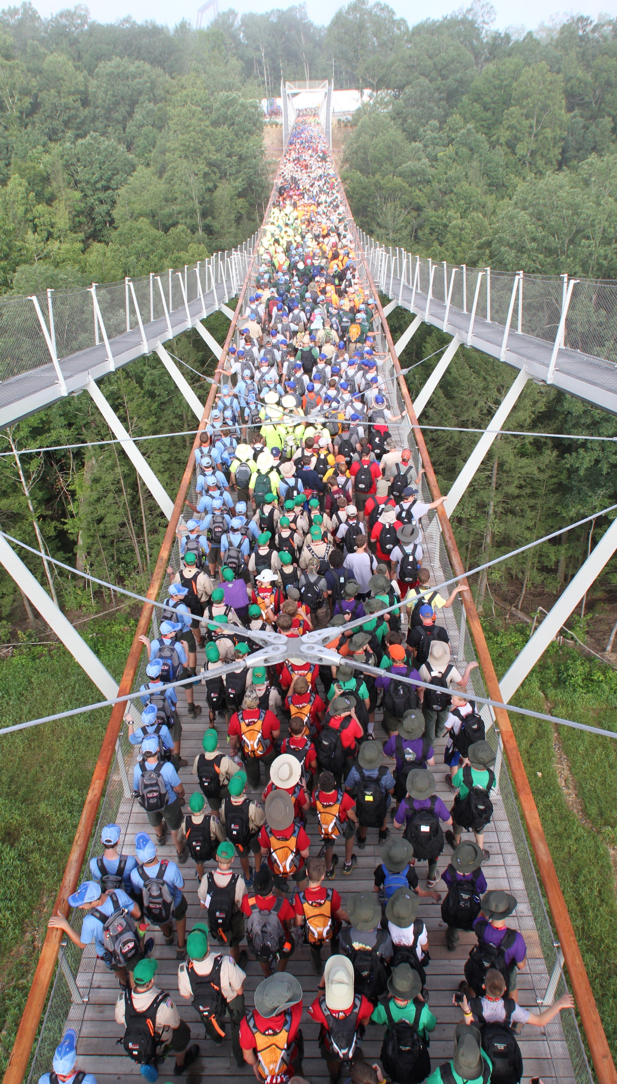
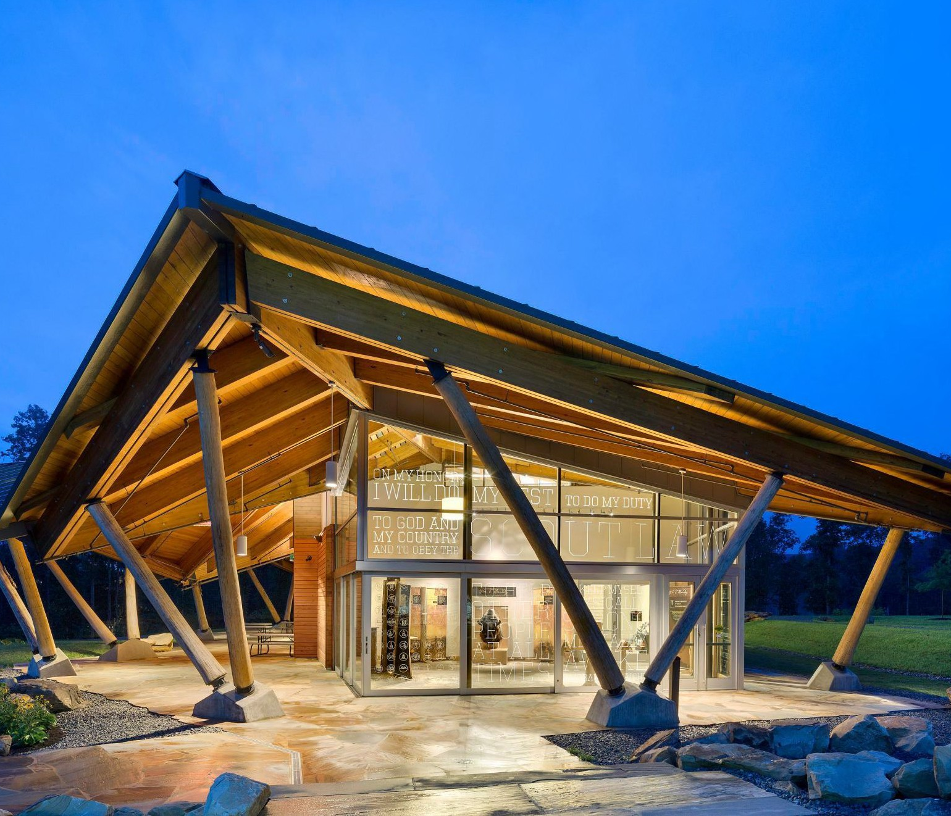
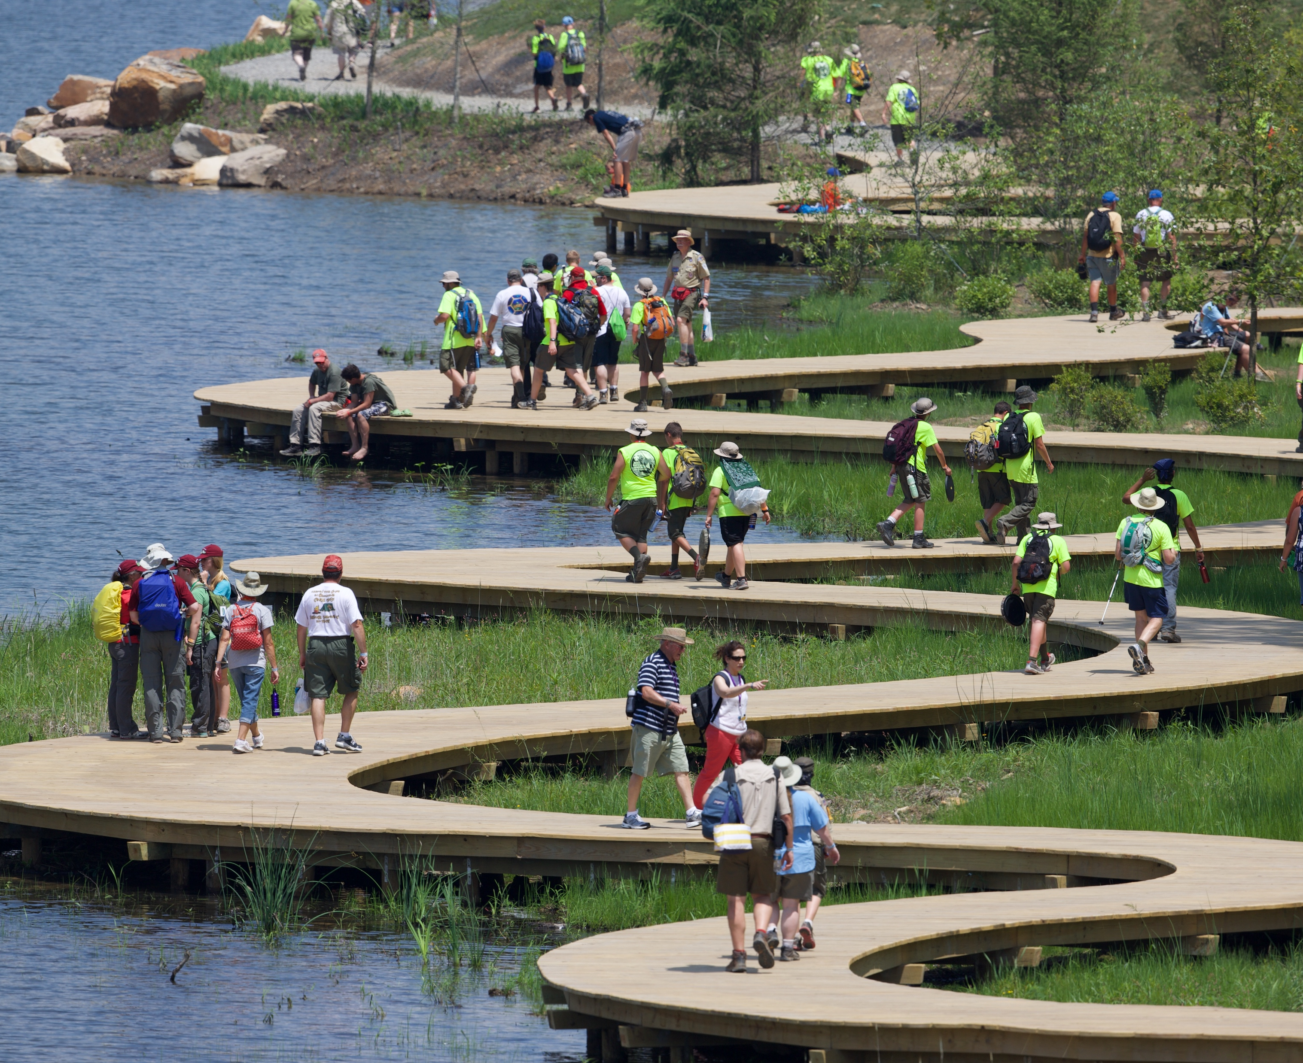
Notes:
Elevate your Scouting at the center of the Jamboree.
From stadium shows to challenging games, outdoor skill-building experiences, perspective-changing programs, merit badge exploration, and “preview versions” of adventure activities at Action Point and Boulder Cove, Scouts and visitors will experience challenges across topics both familiar and new, finding hobbies and pursuits that bring them joy.
Summit Center programs are offered by Scouting organizations, corporate and nonprofit partners, professional and hobby organizations, conservation groups, government agencies, the military, and educational groups — all experts in their field.
Here you can find the Jamboree trading post, the CONSOL Energy Bridge, the Sustainability Treehouse, and all the Scouting you can handle!
You can also walk along the John Gottschalk boardwalk along Goodrich Lake, check out Boulder Cove (climbing and rappelling), and visit the exhibitor areas around the Jamboree.
The Summit Center, including Action Point, is also where visitors will come to experience the Jamboree with participants. Here, they'll get a taste of what the Jamboree is all about.

Slide 10
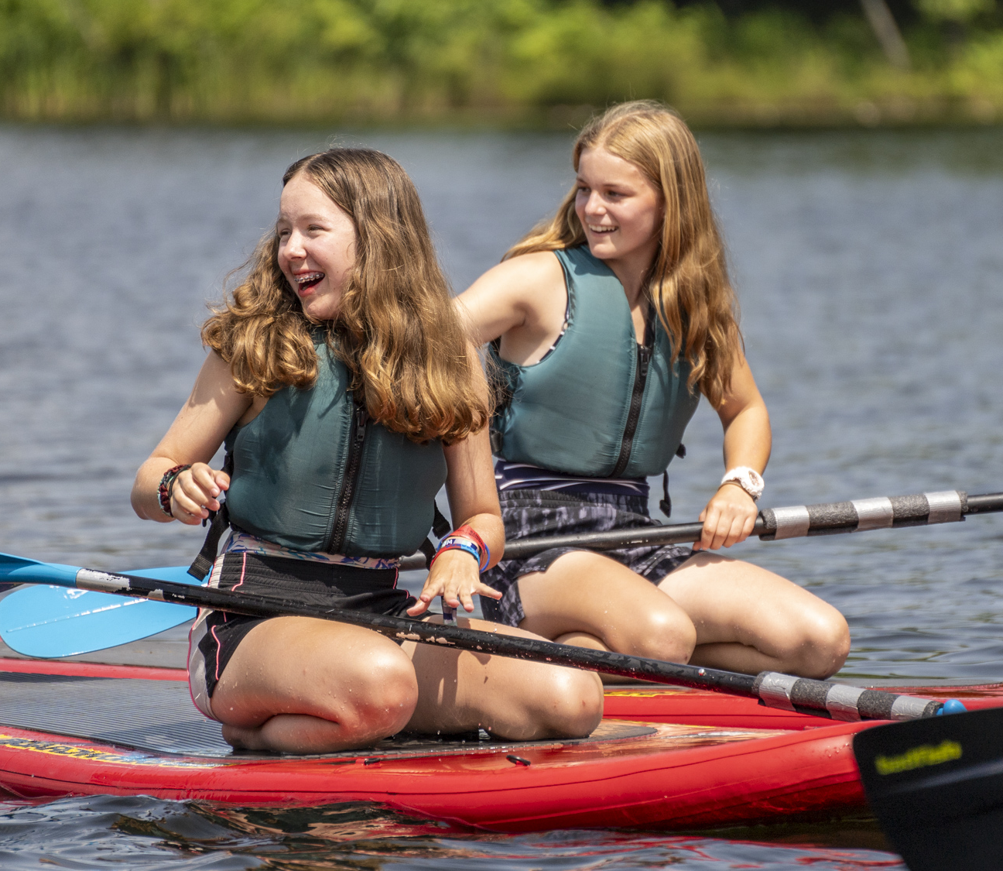
Notes:
Elevate your aquatic adventure with boating, stand-up paddleboarding, and tackling a thrilling water reality obstacle course.
Goodrich lake and Tri-Dave Lake are the backdrops for our Jamboree aquatics activities that will challenge you on a personal, buddy pair, and even the patrol or troop level.
Experience activities from fishing to boating and stand up paddle boards to advanced Kayaking, one of the best ways to cool off at the Jamboree is through our aquatics activities.
Looking for an offsite aquatic adventure? Consider adding a rafting trip to your Jamboree plan through your unit and council. (additional fees required).

Slide 11
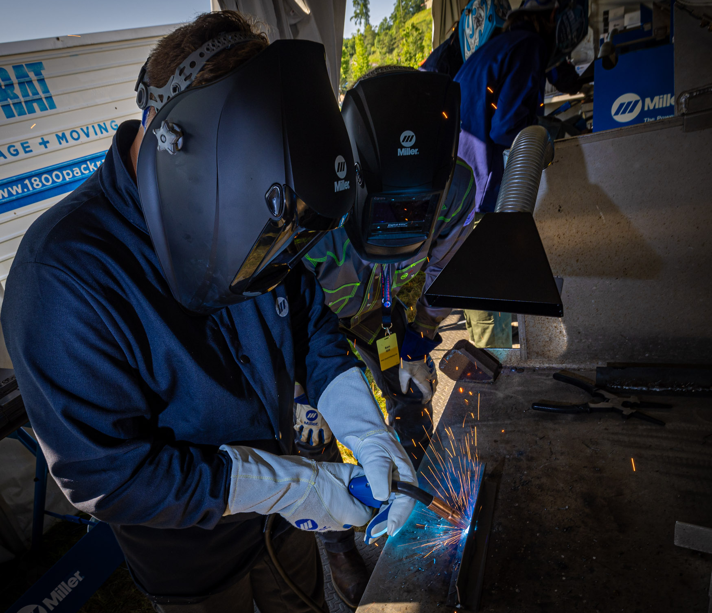
Notes:
Elevate you Advancement through the merit badge offerings
The Jamboree is not meant to be an advancement focused experience, but there will be some opportunities for Scouts who are looking to work on some additional badges.
The open program style will allow Scouts to visit merit badge booths at times that are convenient for Scout and not on a class schedule.

Slide 12
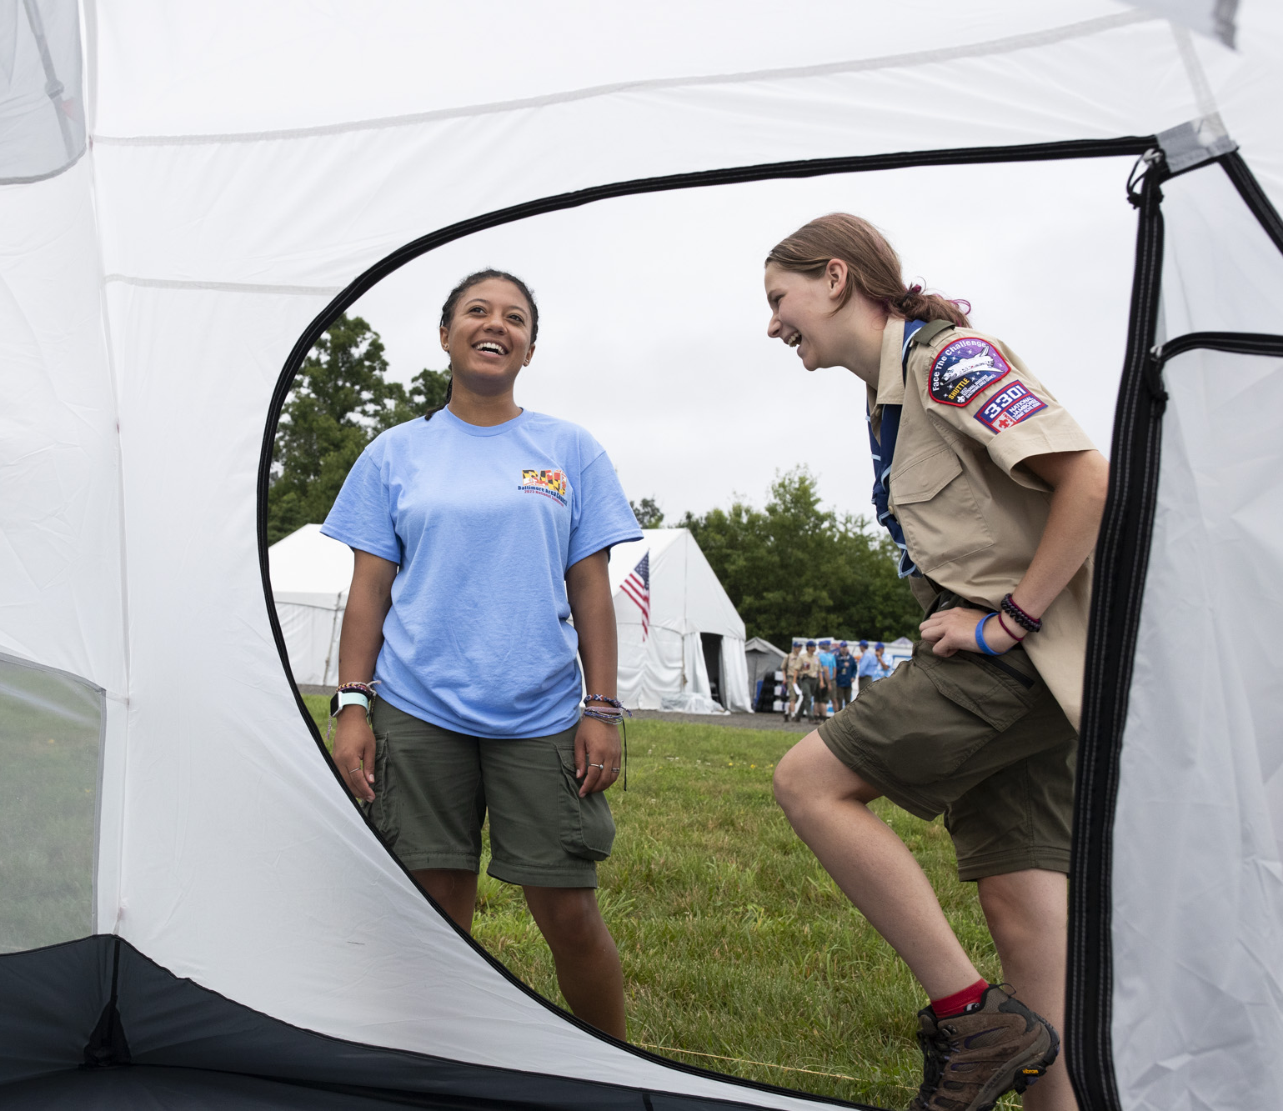
Notes:
Elevate your camping experience and leadership
Scouts will stay together in a campsite which are grouped together in areas we call Basecamps. There will be two basecamps for participants at the Jamboree and one additional Basecamp for staff. Councils will be assigned to basecamps closer to the Jamboree, but know that you will be camped close to all the excitement.
This is the backbone of the Jamboree, the place where you work and play together with your fellow Scouts. From setting up camp on Day 1 to taking it all down on Day 10, this is your home away from home. Experiences like these strengthen units, solidify leadership, and forge friendships.
Beginning on Day 1 of the Jamboree you will have a chance to meet youth from across the country who are sharing a basecamp with you through the Hometown Celebration day. This is a day for you to show off your hometown pride and share with everyone around about what makes your hometown special.

Slide 13
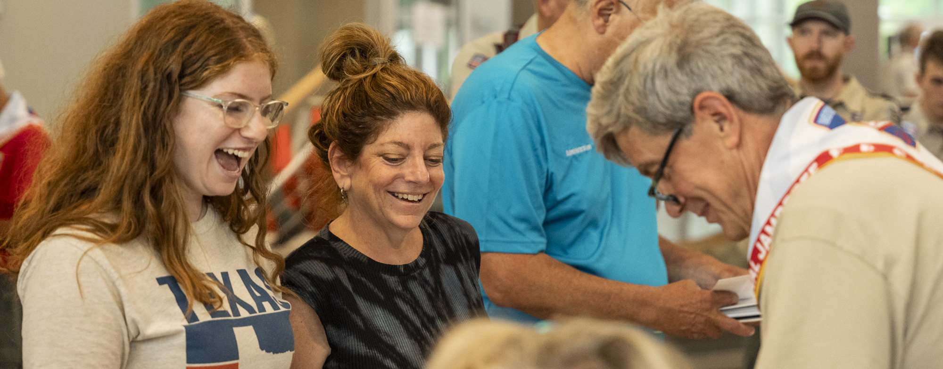
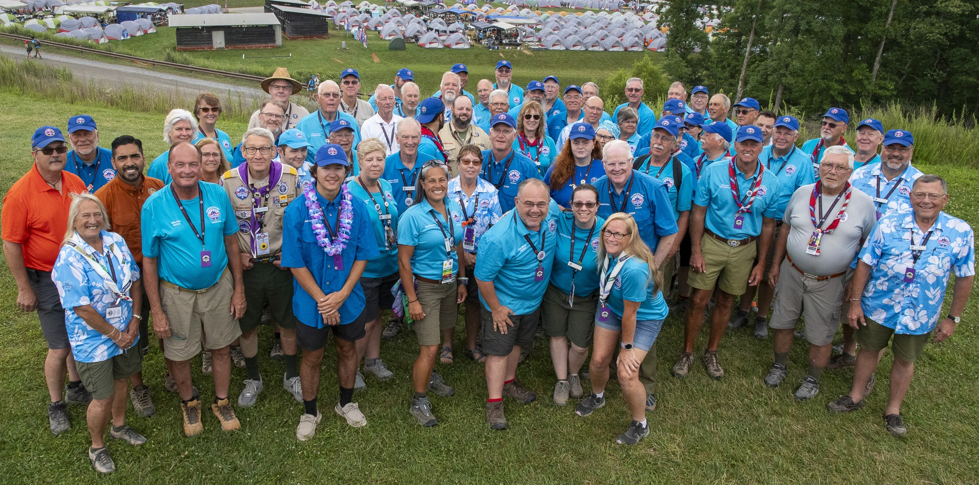
Notes:
Elevate your Jamboree by serving on the Jamboree Service Team (staff)
Whatever you like to do, you can do it on the Jamboree Service Team (staff).
Come experience the Jamboree and make a new group of lifelong friends through our great staff team.
Some Staff benefits include:
Access to your vehicle during the Jamboree – many staff have some time off during the Jamboree and take an opportunity to get off site to explore the local area.
Staff housing in the Echo Basecamp which is a bit removed from the hustle and bustle of the Jamboree participant camping areas.
Lower fee for Jamboree participation
Our goal is for the staff work hours will allow them the opportunity to visit and enjoy other areas of the Jamboree outside their assigned work area.
Communications—A robust communications strategy will be developed and executed to keep staff members informed from the date they register as a staff member through the last day of the Jamboree.
Lodging—Staff will have the ability to bring their own tent to have the most comfortable experience possible.
Staff Camping—The staff camping area will be designed to provide an area in which staff members can relax, recreate, and refresh themselves in the company of other staff members. Retail food and beverage stands will be incorporated in this design.

Slide 14
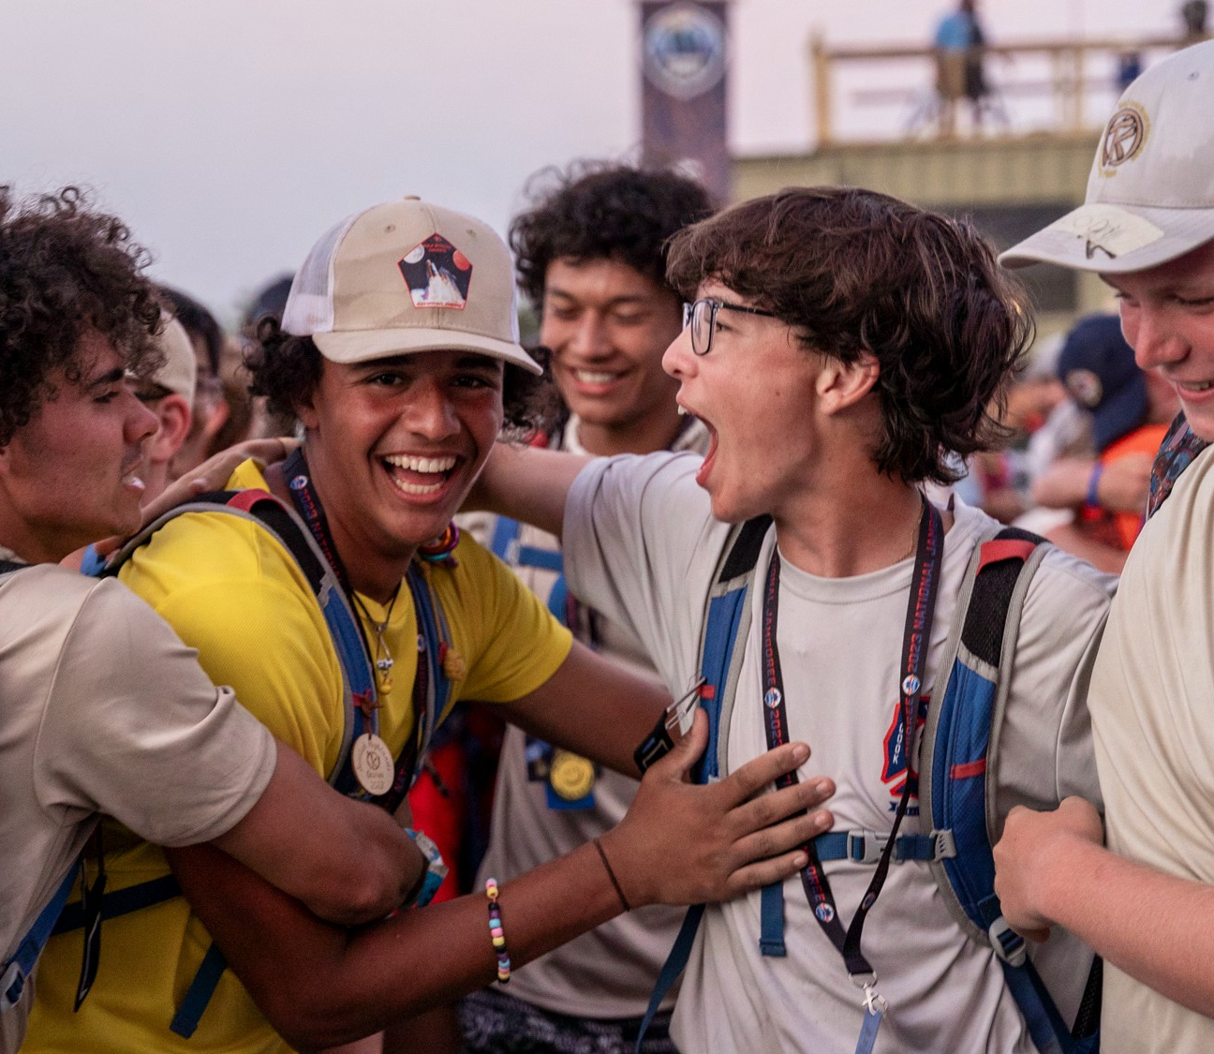
Notes:
After hearing all of this the only question left is when can I sign up.
Individual staff registration will open in the fall of 2024 through the Jamboree registration system.
Contingent registration will be managed through the local council. For information about attending as a part of your council’s Jamboree contingent reach out to your council.
Being look for updates via email and social media for more information around registration opening.

Slide 15
